Slide 1
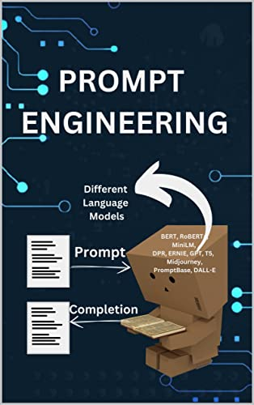


ChatGPT Prompt Engineering for Developers
Peddireddy Srijith
21071A7252 (AI & DS)
Source :- https://learn.deeplearning.ai/

Slide 2

Agenda
1
2
3
4
5
Introduction
Guidelines
Iterative
Summarizing
Inferring
6
7
8
OpenAi doc
Chatbot
Conclusion
Expanding

Slide 3
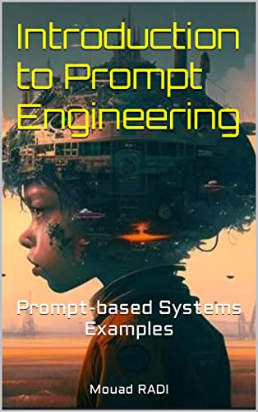
Introduction
Prompt engineering is a relatively new discipline for developing and optimizing prompts to efficiently use language models (LMs) for a wide variety of applications and research topics. Prompt engineering skills help to better understand the capabilities and limitations of large language models (LLMs). Researchers use prompt engineering to improve the capacity of LLMs on a wide range of common and complex tasks such as question answering and arithmetic reasoning. Developers use prompt engineering to design robust and effective prompting techniques that interface with LLMs and other tools.​

Slide 4
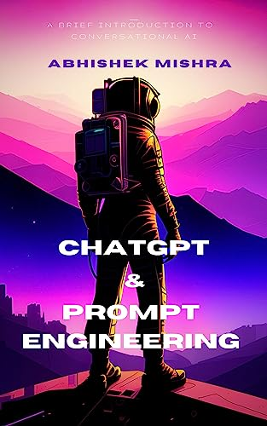
Guidelines
Prompting Principles¶
Principle 1: Write clear and specific instructions
Principle 2: Give the model time to “think”
Tactics
Tactic 1: Use delimiters to clearly indicate distinct parts of the input
Tactic 2: Ask for a structured output
Tactic 3: Ask the model to check whether conditions are satisfied
Tactic 4: "Few-shot" prompting

Slide 5
Guidelines
Principle 2: Give the model time to “think”
Tactic 1: Specify the steps required to complete a task
Ask for output in a specified format
Tactic 2: Instruct the model to work out its own solution before rushing to a conclusion.
Model Limitations: Hallucinations
Ex :- Boie is a real company, the product name is not real.

Slide 6
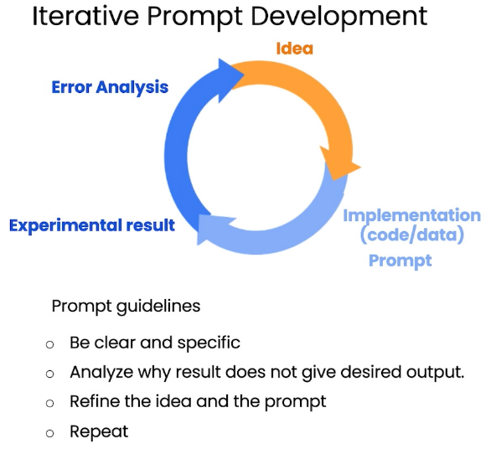
Iterative Prompt Develelopment
Issue 1: The text is too long
Limit the number of words/sentences/characters.
Issue 2. Text focuses on the wrong details
Ask it to focus on the aspects that are relevant to the intended audience.
Issue 3. Description needs a table of dimensions¶
Ask it to extract information and organize it in a table.

Slide 7
Summarizing
Summarize with a word/sentence/character limit
Example prompt = “Your task is to generate a short summary of a product \
review from an ecommerce site. Summarize the review below, delimited by triple
backticks, in at most 30 words.”
Summarize with a focus on shipping and delivery
Summarize with a focus on price and value
Summarize multiple product reviews

Slide 8





Inferring
Sentiment (positive/negative)
Give your answer as a single word, either "positive" \
or "negative".
Identify types of emotions
Identify anger
Inferring topics
Make a news alert for certain topics

Slide 9
Transforming
Translation
“Translate the following English text to Spanish:”
Universal Translator
“Different lines of sentences of different languages to Engllish”
Tone Transformation
“Dude to Sir/Madam”
Format Conversion
“python dictionary from JSON to an HTML Table”
Spellcheck/
Grammar check
“correct the following text
and rewrite the corrected version”

Slide 10
Expanding
Generate customer service emails that are tailored to each customer's review.
Customize the automated reply to a customer email
Remind the model to use details from the customer's email
Try experimenting on your own!
Try on chatgpt website or use API in jupyter notebook using openai lib

Slide 11

Chatbot
you can utilize the chat format to have extended conversations with chatbots personalized or specialized for specific tasks or behaviors.
https://learn.deeplearning.ai/chatgpt-prompt-eng/lesson/8/chatbot

Slide 12

Conclusion
Principles:
• Write clear and specific instructions .
• Give the model time to "think“
• Iterative prompt development
Capabilities: Summarizing, Inferring,
Transforming, Expanding
• Building a chatbot

Slide 13
Official Guide
https://platform.openai.com/docs/guides/prompt-engineering
The above docs was given by openai official platform as a guide

Slide 14

Thank you
Peddireddy srijith
peddireddysrijith@gmail.com

